Slide 1


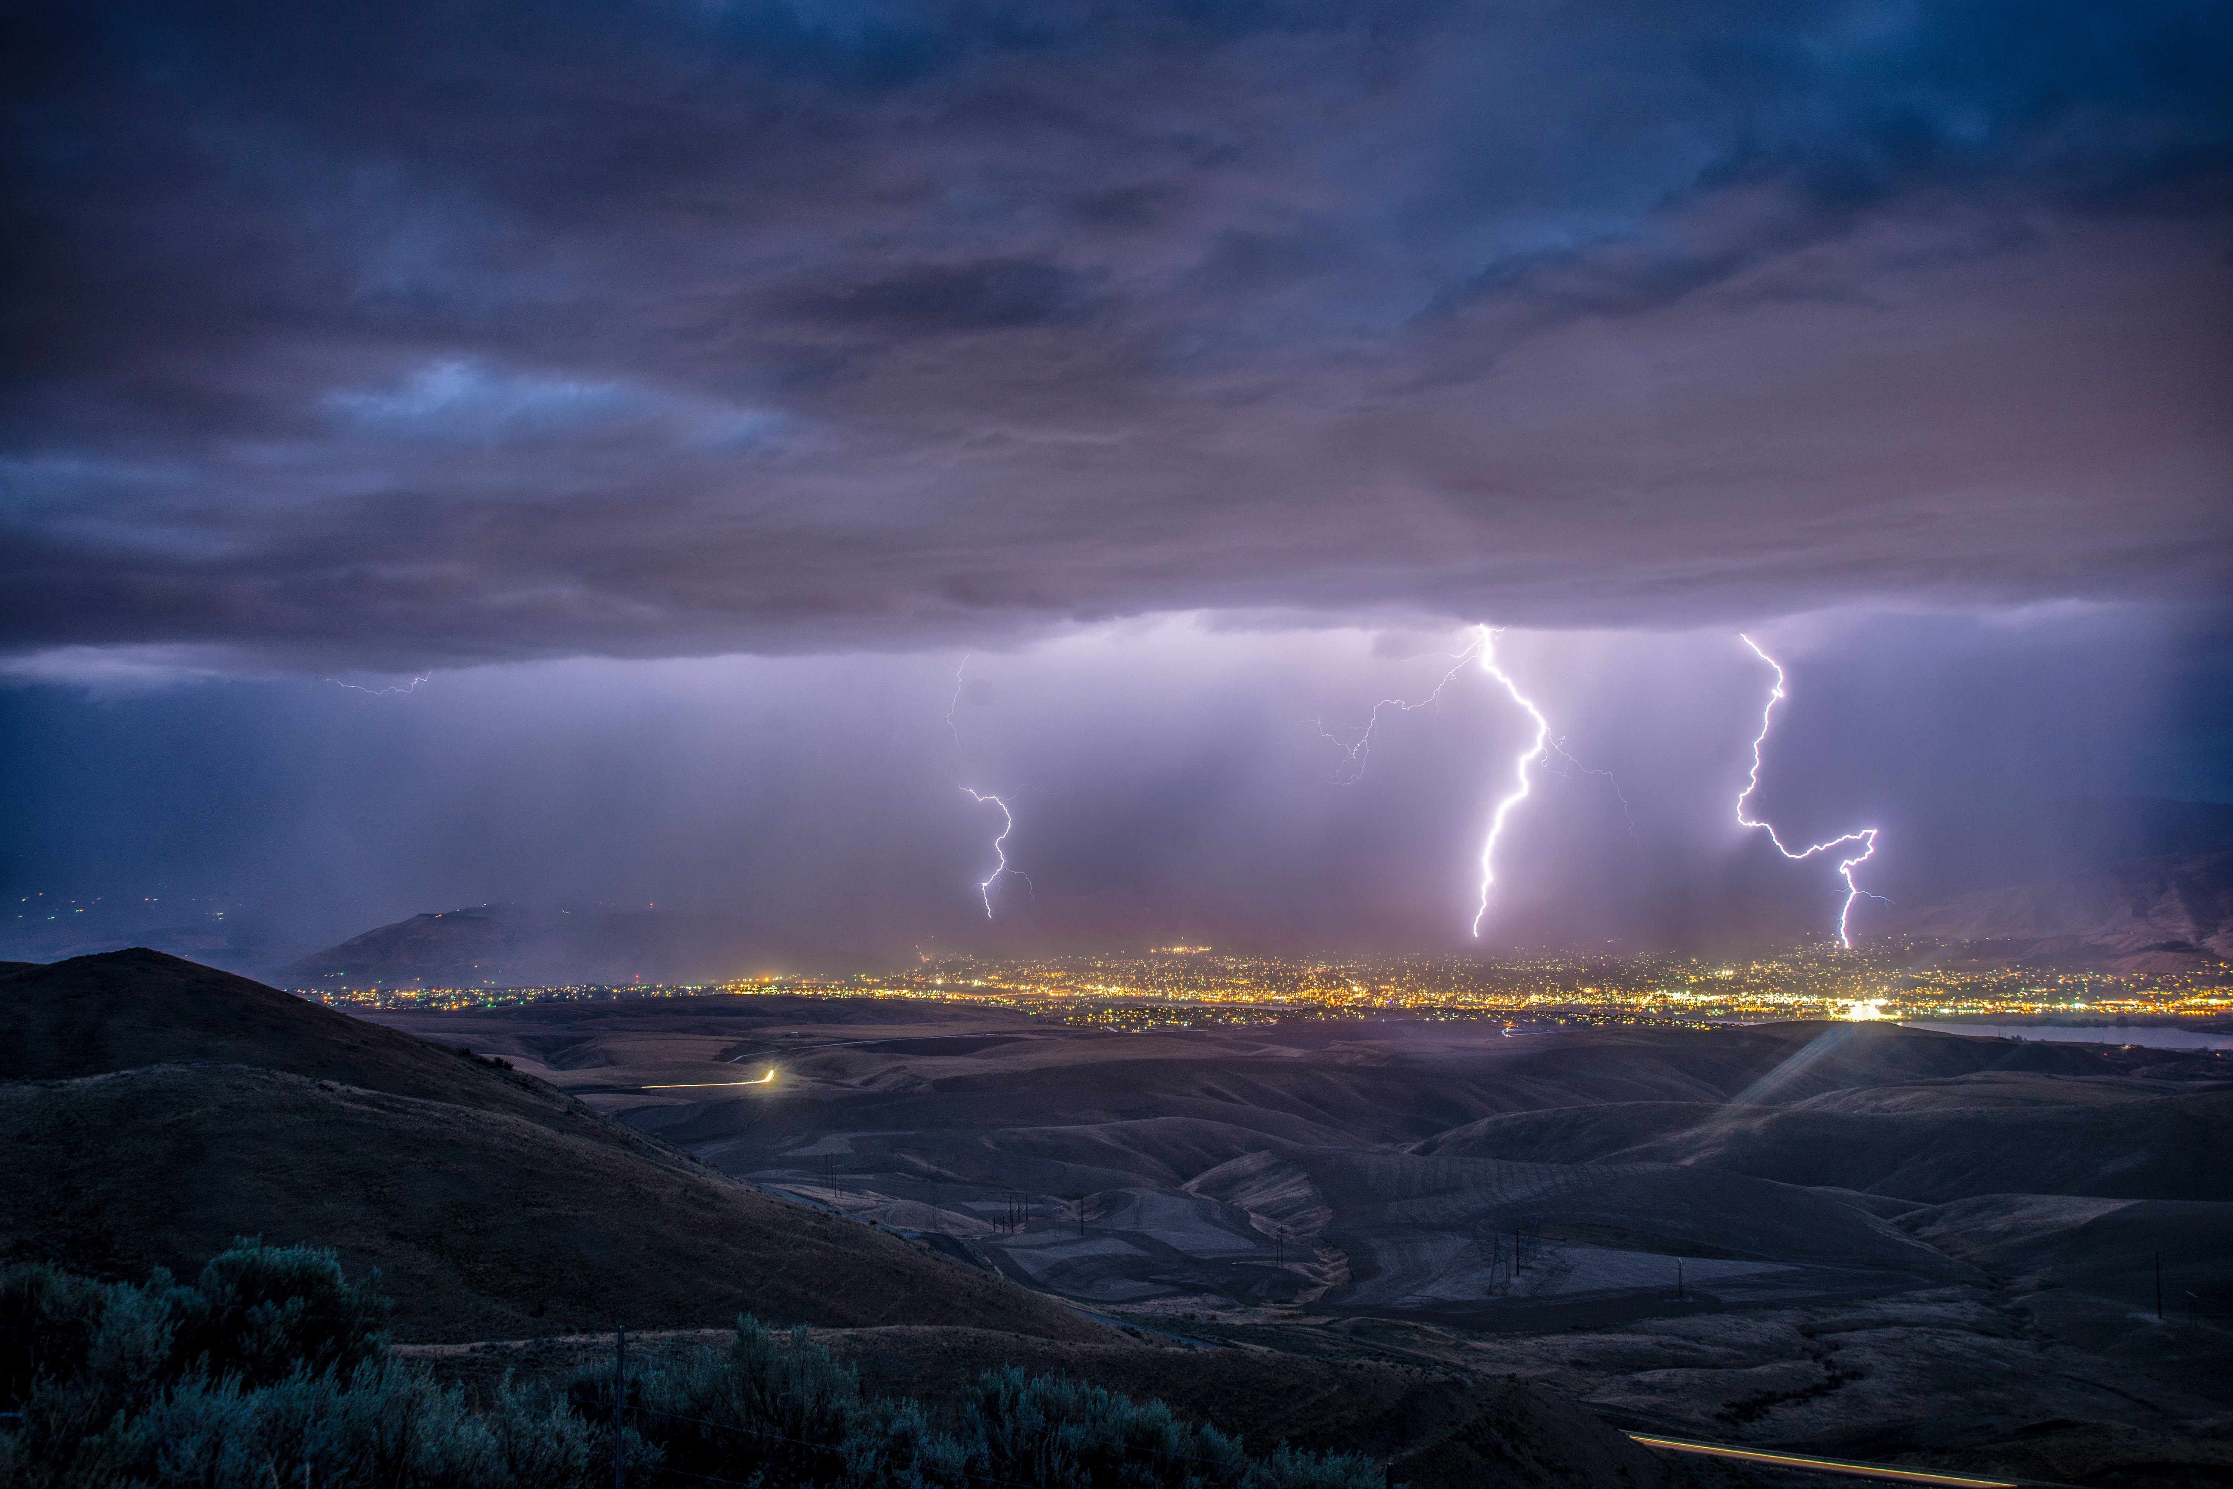


The Dream Climate App
Your Futuristic Weather Companion
A revolutionary climate app designed to provide you with real-time weather data, location-based forecasts, historical information, outfit suggestions, weather alerts, dark/light mode and so much more.
Get ready to experience weather like never before❗
DT
by The Dream Team

Slide 2
Feature Highlights
🌤️Real-time Weather Data
👗 Outfit Suggestions
Stay up-to-date with the most accurate and timely weather information.
Receive personalized recommendations to dress appropriately for the weather.
📊Historical Data
📍 Location-based Forecasts
Explore past weather patterns and trends for any location.
Get weather predictions tailored specifically to your current location.

Slide 3
👀A Glimpse into the app
Simplicity & Elegance
Our app's user interface is designed to be intuitive, elegant, and easy to navigate.

Slide 4
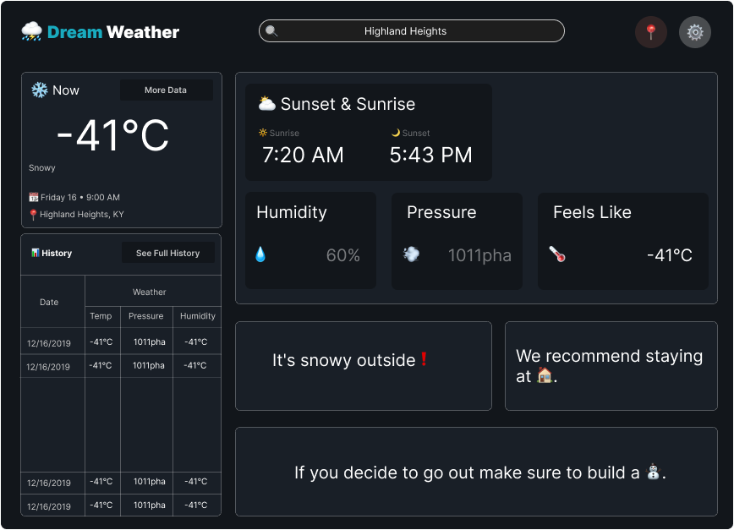

Slide 5
ℹReliable Climate Information
Accurate and Trustworthy
Rest assured, our app sources its weather data from the reputable OpenWeather API, guaranteeing the utmost reliability and up-to-the-minute accuracy.
Data You Can Depend On
Our app ensures you receive weather information you can trust, providing confidence in your daily plans.
On Demand Weather Updates
Stay ahead of the weather with real-time updates, keeping you informed and prepared for any climate changes.

Slide 6
👗Never Dress Inappropriately
Smart Outfit Recommendation system
Say goodbye to mismatched outfits – our app suggests the perfect attire for any weather.

Slide 7
🔔Stay Informed with Alerts
Real-time Weather Alerts
Receive instant notifications about severe weather conditions and stay informed at all times.

